Slide 1
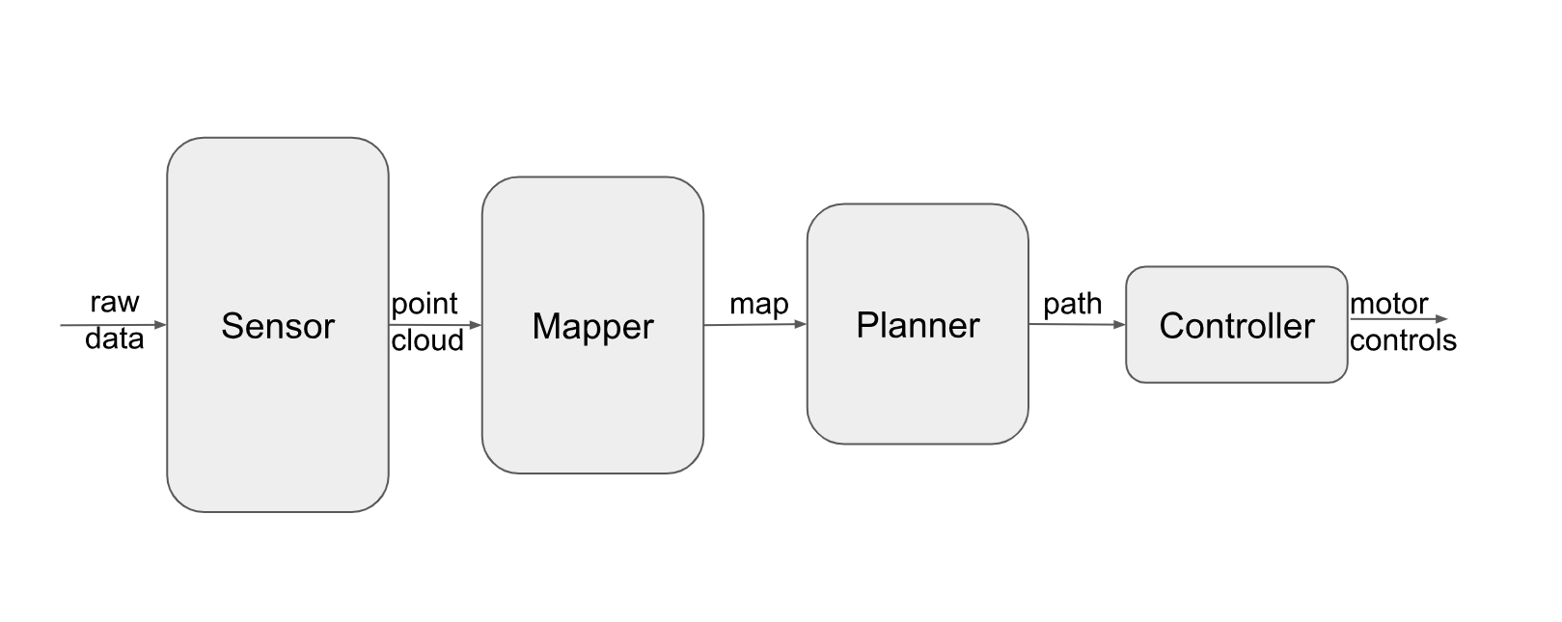
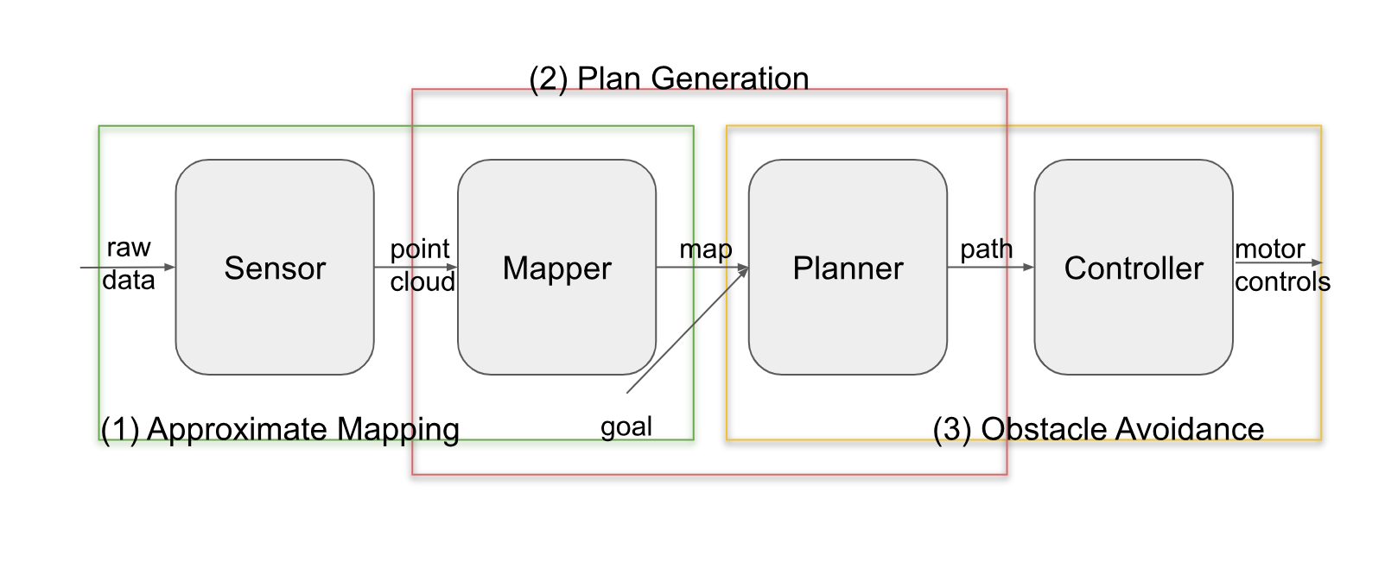
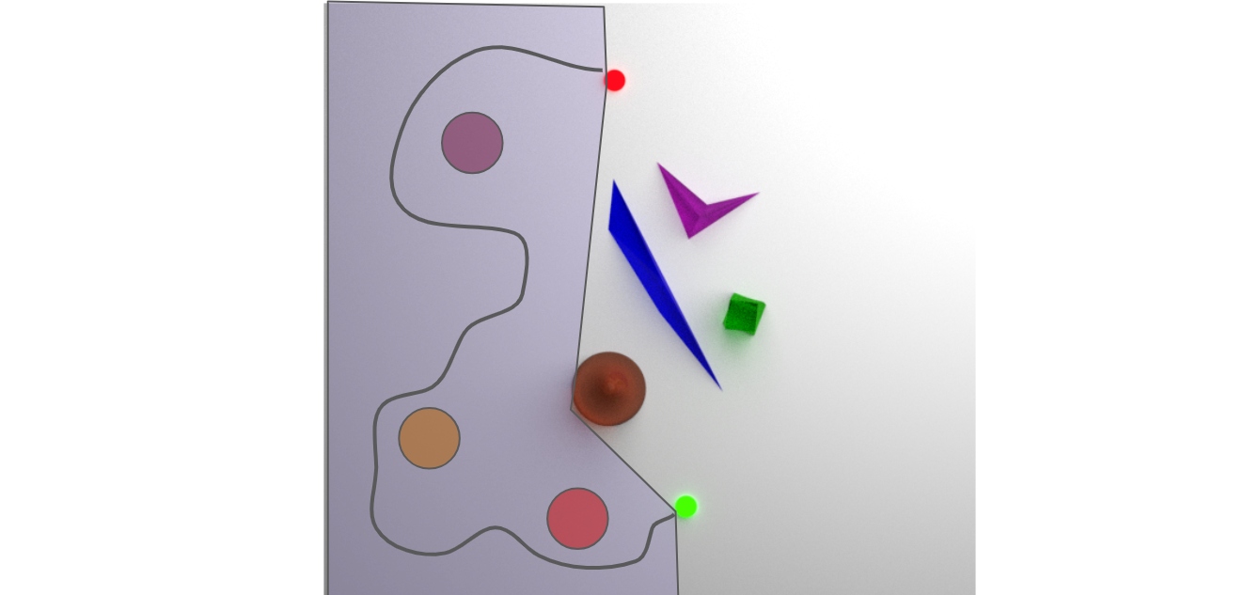
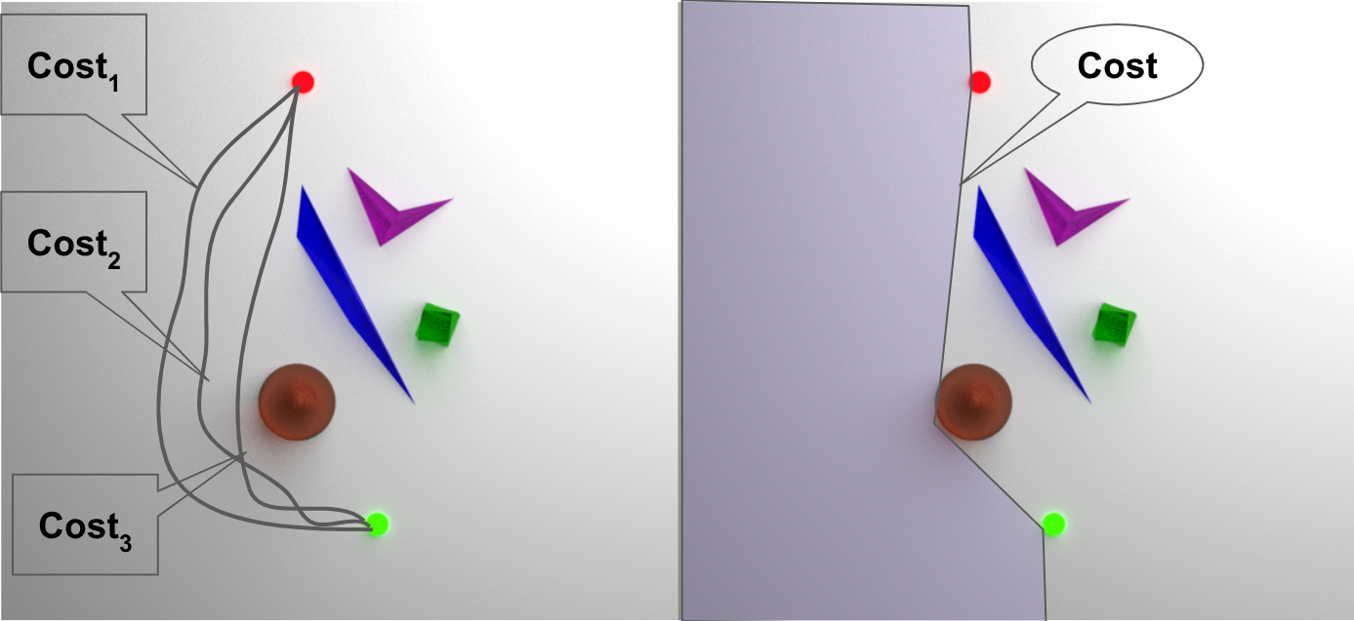
Minimalist Motion Planning Using Global Topological Guarantees
Claire Liang {cyl48@cornell.edu} and Ross A. Knepper {rak@cs.cornell.edu}
Cornell University Department of Computer Science
Guarantees*
Safety: The robot will navigate collision-free.
Correctness: The robot will get from the starting point to the goal point.
Completeness: If there exists a valid path for the robot to get from the starting point to the goal point, the robot will find and take this path.
Fig. 1
The Planner Today
Although there are many valid motion plans for any given problem, each step of traditional motion planners grows increasingly specific, ultimately narrowing down to one precise trajectory (see Fig. 1). This method provides important guarantees*, but committing to a specific path runs the risk of the path becoming infeasible before it can even be executed by the robot.
Research Questions
1. How does the planner impose restrictions on the controller?
2. If loops around obstacles are to be considered, is it best done at the path specification stage? How?
3. How little sensing can we get away with for our map and still allow us to plan? What guarantees do we need from our map to be able to plan?
Fig. 2
The Alternative
To evade the issues from an overly precise plan specification, we instead specify homotopy classes rather than trajectories (see Fig. 3) . This alternative should provide the same guarantees* as the planner today by grouping steps as shown in Fig 2.
Fig. 4
Benefits
Allows for the flexibility of a controller that can optimize and react in real time (see Fig.4).
For human users, a homotopy class specification may align better with their desired behavior for the robot.
It may be possible to get away with less metric specificity, requiring less sensor input from the very beginning.
Homotopy Class Specification
Fig. 3
A Minimalist Global Map
Metric information needs to exist from the beginning to do useful planning, but how much is necessary? With our alternative approach, it is sufficient to have relative ordering of the position of obstacles.

